Slide 1
Music Recommendation System
Group members:
Chinmay Patil (BT20ECE074)
Rohan Chembakasseril (BT20ECE084)
Rudra Sanyal (BT20ECE085)
Sarthak Atal (BT20ECE088)
Vedan Shet (BT20ECE093)

Slide 2
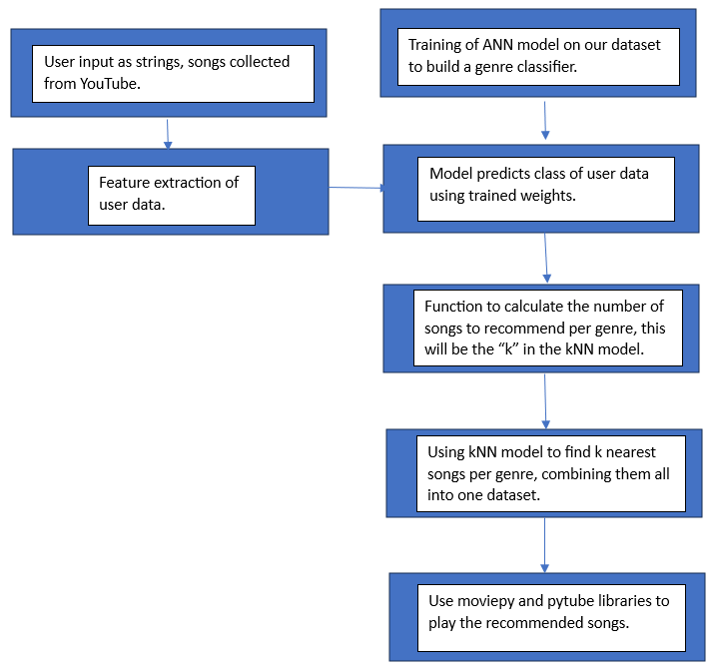
Project Workflow Overview

Slide 3
Data Collection
-Github repository:
Github repository containing hindi music of seven different classes: bhajan, bhojpuri, bollywood rap, bollywood romantic, sufi, garhwali, and ghazal having about 80-100 songs of each class
-Youtube: we used youtube to collect music samples of various street artists and instrumental music. 2 new classes were added to the above data, raw_music and instrumentals.

Slide 4
Data preprocessing
We are using the librosa library to extract audio features from a song such as onset_strength, mfcc, melspectrogram, chroma_cens, zero_crossing_rate etc. which is giving us the information about our song.
These values will be the features associated with the song that our ANN model will learn to map to the class.
Each song has its corresponding class associated with it

Slide 5
Models used:
1)ANN(Artificial Neural Network)
We have used a simple ANN that can learn the mapping of our feature data to its corresponding class.
Our model architecture has 12 nodes in the input layer, 5 hidden layers, and 9 nodes in the output layer for 9 different classes. We are applying One Hot Encoding to the labeled classes.
We are using ReLU and SeLU(scaled exponential Linear Unit) activation functions. We are using Adam_optimizer and cross-entropy loss to train our data.

Slide 6
2)KNN(K-Nearest Neighbors)
K-Nearest Neighbors (KNN) is a simple yet effective supervised machine learning algorithm used for classification and regression tasks. The core idea behind KNN is to make predictions based on the majority class or the average of the nearest data points in a feature space.
After the ANN has classified the user’s playlist into different classes, we will apply kNN for each class that has to be recommended
For kNN, we are using the ball_tree algorithm.

Slide 7
-BALL TREE kNN
A Ball Tree is a data structure commonly used in computer science and machine learning to optimize the k-nearest neighbors (KNN) algorithm, a technique for classification and regression tasks.
The Ball Tree is designed to efficiently organize and partition data in a hierarchical binary tree structure, where each node represents a hypersphere containing data points. During KNN queries, the tree is traversed from the root to leaf nodes, and pruning techniques help reduce unnecessary distance calculations.
This approach is especially beneficial for high-dimensional data, where traditional KNN searches can suffer from the curse of dimensionality. Libraries like scikit-learn provide implementations of Ball Trees, making it easier to apply this structure to KNN-based tasks and enhance their computational efficiency.

Slide 8
Input format:-
We take the input from the user as a series of strings entered in the terminal. This can be of any size that the user wishes.
User can enter the song names in his playlist. We will fetch the audio file for that song through pytube and moviepy libraries in python
And we will pass those songs to our feature extraction function so that our model can predict it’s class after training.

Slide 9
Output format:-
Based on the ratios, the corresponding recommended songs are chosen and displayed as strings. These are downloaded and then played within the python environment.

Slide 10
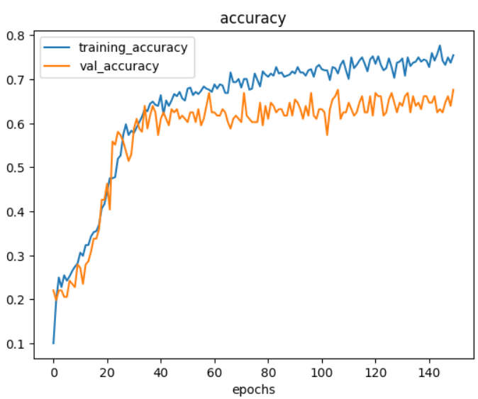
Results for network training

Slide 11
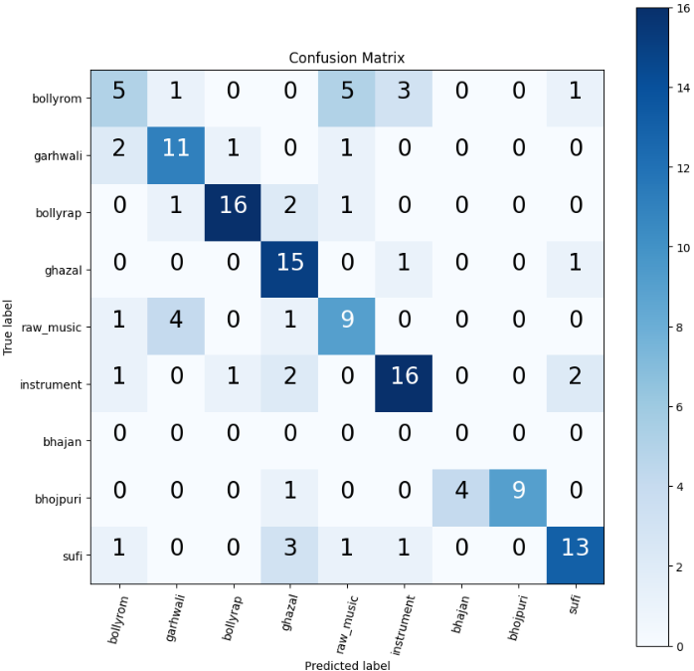
Confusion matrix for validation set

Slide 12
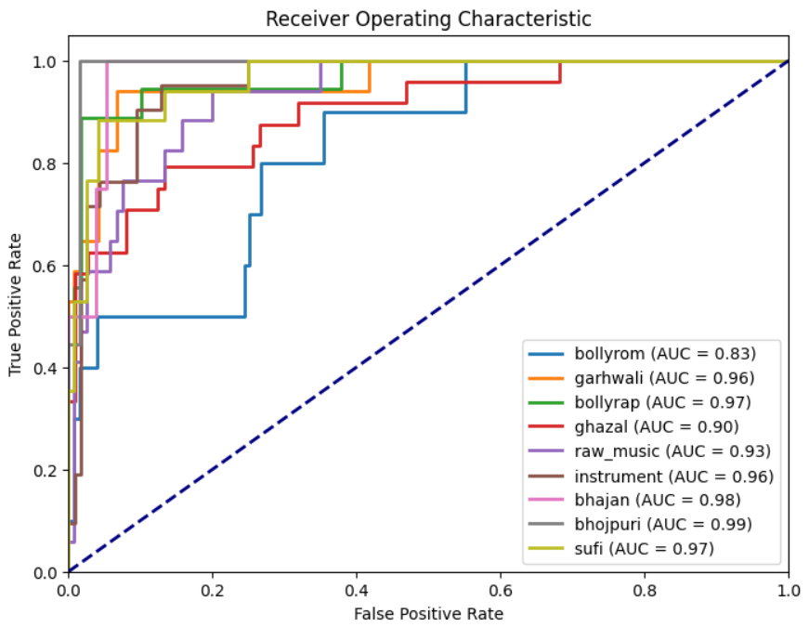
ROC for different genres

Slide 13
Conclusion:-
A music recommendation system that takes variable sized input from the user, extracts the audio file, extracts audio features, creates data frames to be fed to the artificial neural network, decides recommendation based on the ratio of classes in the output of ANN, and plays the recommended songs live, has been successfully built.

